Slide 1
Chapter 2 Review
Accompanying PowerPoint

Slide 2
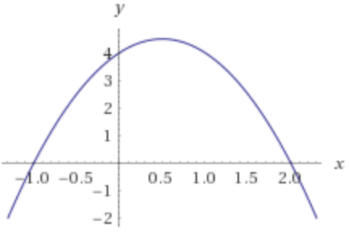
Find the vertex of the parabola f(x) = -2x² + 2x + 4 and sketch its graph.

Slide 3
Find a polynomial of degree 7 whose zeros are -2, 0, 1 (multiplicities 2, 4, 1 respectively)
f(x) = x⁷ + 3x⁶ – 4x⁴

Slide 4
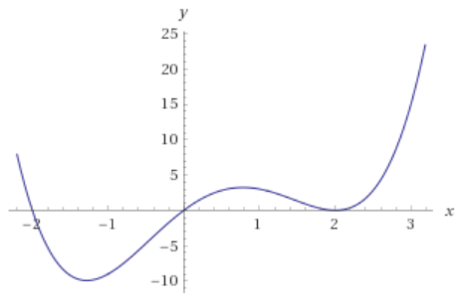
Graph the polynomial f(x) = x(x + 2)(x – 2)²

Slide 5
Upper and Lower Bounds for Real Zeros
Let f(x) be a polynomial with real coefficients and a positive leading coefficient. Suppose we perform synthetic division on f using x = c.
If c is positive and each number in the bottom row is either positive or zero, c is an upper bound for the real zeros of f.
If c is negative and the numbers in the bottom row are alternating positive and negative (zero being allowed), c is a lower bound for the real zeros of f.
Ex: Find the real zeros of f(x) = 4x³ – x² + 36x – 9.
4 -1 36 -9
4 3 39
4 3 39 30

Slide 6
Factor P(x) = x⁴ – 3x³ + 6x² – 12x + 8
Apply Descartes’ Rule of Signs
Use the Rational Zero Theorem to find the possible rational zeros
Use upper/lower bound rule to determine which possibilities to throw out.

Slide 7
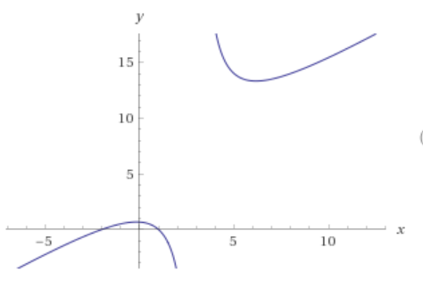

Graph the function f(x) = $\frac{x^{2}−3x −4}{x+2}$
Steps
Find the domain.
Find the intercepts.
Find any holes.
Find the asymptotes.
Find additional points on the graph.
Sketch the graph.

